Slide 1
A High Performance Framework for Large-scale 2D Convolution Operation on FPGA
Dawang Zhang, Zhisong Bie

Slide 2
Contents
Introduction of 2D convolution operation
Disadvantages of prior works and our motivation
Improvement of PE
Prior convolution PE
Improved convolution PE
Structures for large-scale operation
Optimization of on-chip memory
Block calculation
Performance Analysis

Slide 3
What is 2D Convolution operation
The 2D convolution operation is to convolve the feature maps of the previous layer with a plurality of learnable kernels to form the feature maps of the next layer.

Slide 4
Disadvantages of Prior works
Lots of computing resources will be wasted for the traditional designed PE when the stride of operation is larger than 1.
Most works focus on small CNN networks such as LeNet and AlexNet.

Slide 5
Our motivation
Redesign convolution PE to eliminate redundant calculation.
Convolution operation of any size can be accelerated in low-level FPGAs while high memory bandwidth is not needed.

Slide 6
Prior convolution PE
Z-type PE is designed to reduce the memory access times
When the stride(x) of convolution operation is larger than 1, we need to wait x-1 cycles to get the calculation result.

Slide 7
Improved convolution PE
Basic idea: Store the 9 numbers in a calculation window in 9 small rams so that we can load 9 numbers each cycle
Store:
Load:
The location of number in (x, y):

Slide 8
Optimization of on-chip memory
There are two structures to optimize the usage of on-chip memory.

Slide 9
Block calculation
Block calculation is to divided a large-scale 2D convolution operation into some small-scale 2D convolution operations.

Slide 10
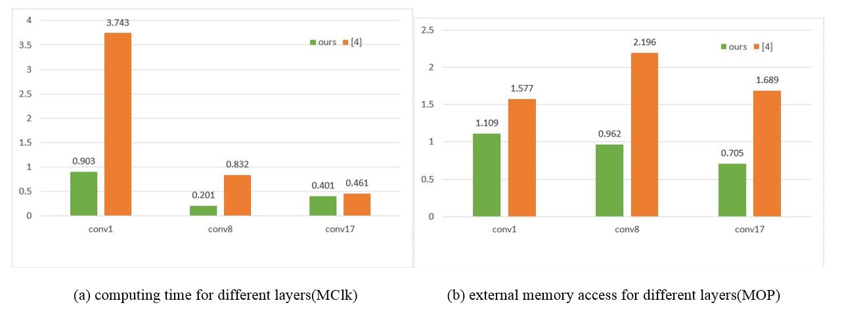
Performance Analysis
Comparison between our work and prior work based on roughly the same calculation and on-chip memory resources.

Slide 11
Thanks!
please feel free to contact me at: zdawang@bupt.edu.cn

